Slide 1

Capstone Project - 3
HEALTH INSURANCE CROSS SELL PREDICTION
By:– Ajit Padole

Slide 2

Content
Problem Statement
Data Summary
Data Visualization(EDA)
Feature Transformation
Feature Encoding
Feature Selection
Balancing Imbalanced Dataset
Model Fitting
Model Selection( Various Classification Algorithms )
Hyperparameter tuning
Conclusion

Slide 3

Problem Statement
Our client is an Insurance company that has provided Health Insurance to its customers now they need your help in building a model to predict whether the policyholders (customers) from the past year will also be interested in Vehicle Insurance provided by the company.
Data shape(381109, 12)

Slide 4

Data Summary
id: Unique ID for the customer
Gender: Gender of the customer
Age: Age of the customer
Driving_License 0: Customer does not have DL, 1:Customer already has DL
Region_Code: Unique code for the region of the customer
Previously_Insured:1:Customer already has Vehicle Insurance, 0 : Customer doesn't have Vehicle
Insurance
Vehicle_Age: Age of the Vehicle
Vehicle_Damage:1:Customer got his/her vehicle damaged in the past. 0 : Customer didn't get his/her
Vehicle damaged in the past.
Annual_Premium:The amount customer needs to pay as a premium in the year
PolicySalesChannel: Anonymized Code for the channel of outreaching to the customer ie. Different Agents, Over Mail, Over Phone, In Person, etc.
Vintage: Number of Days, Customer has been associated with the company
Response:1:Customer is interested, 0 : Customer is not interested.

Slide 5
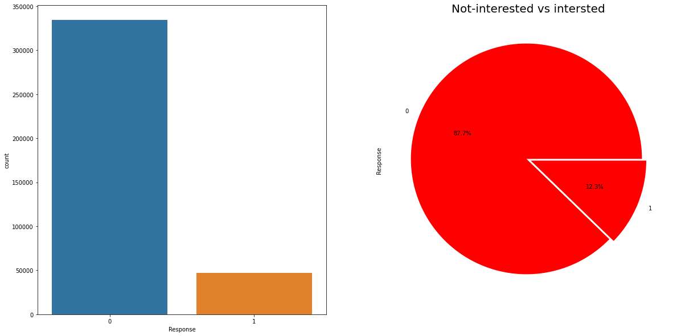
Data Visualization(EDA)
Target variable response
Response (Dependent Variable)
Response:- 1:Customer is interested, 0:Customer is not interested

Slide 6
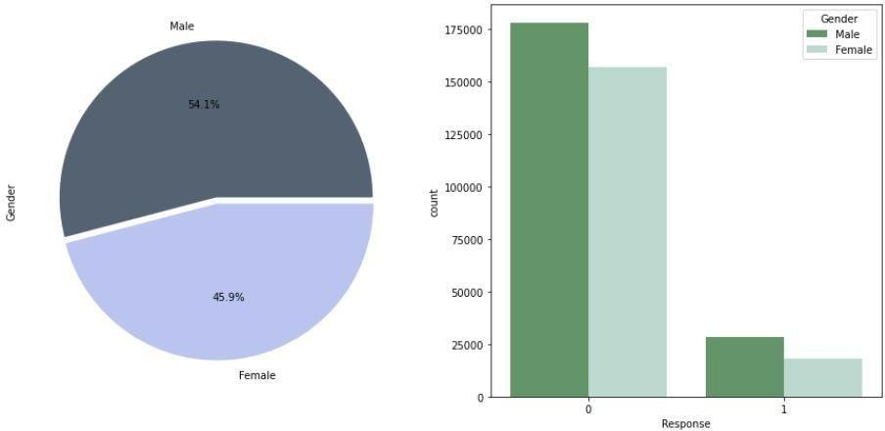
Data Visualization(EDA)
Gender of the customer Vs. Response
From the below plots, we can see the number of men is a bit more than women, so we have a little gender gap here.
Males seem to have more interest in vehicle insurance than women, so we have to target women more to increase the conversion rate of women for vehicle insurance.

Slide 7
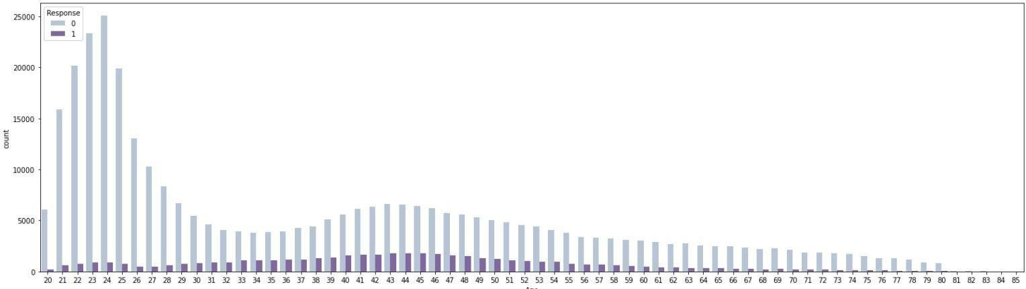
Data Visualization(EDA)
Age Vs. Response
Here we can see customers in their 30s-60s are most interested in vehicle insurance, which is quite natural as the mature generation are aware of insurance and its benefit.

Slide 8
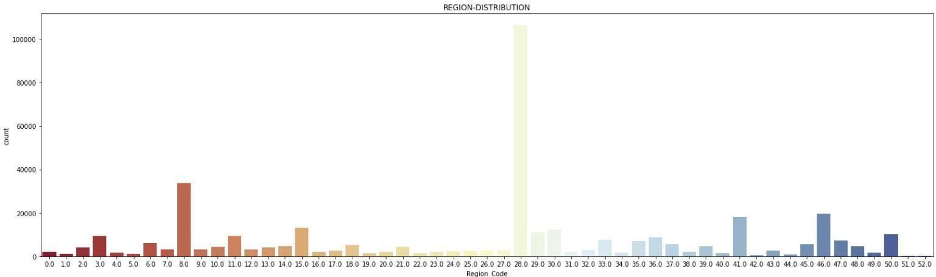
Data Visualization(EDA)
Analysing region feature
Region 28 has Highest number of customer interest in vehicle insurance.

Slide 9
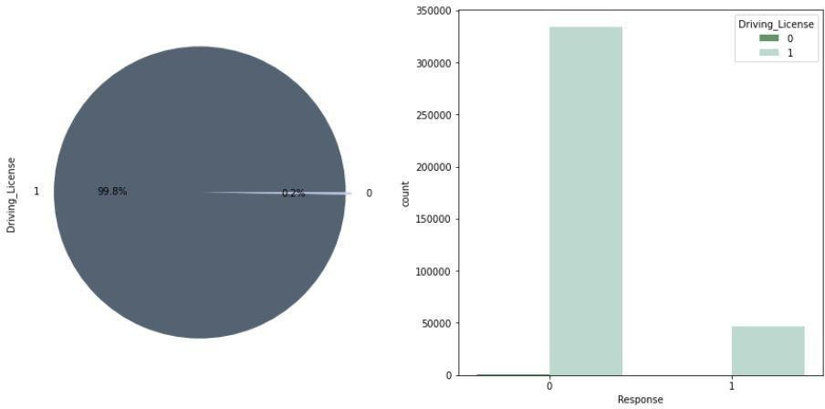
Data Visualization(EDA)
Driving License effect on Response feature
Customer without a driving license is just 0.2% of all customer, we can conclude that almost every customer has a driving license.

Slide 10
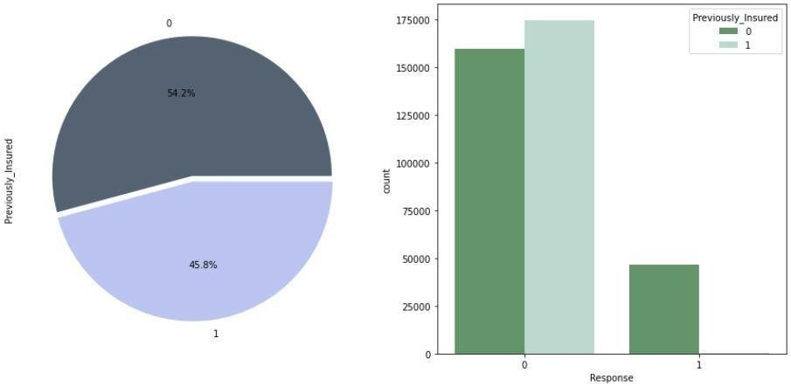
It seems that customer that already had vehicle insurance tends to have less interest in hanging another vehicle insurance.
Data Visualization(EDA)
Previously Insured effect on response feature
1:Customer already has Vehicle Insurance, 0:Customer doesn't have Vehicle Insurance

Slide 11
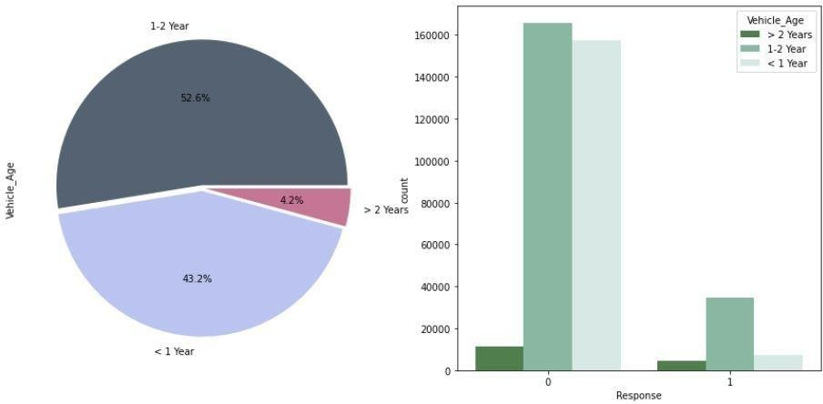
Data Visualization(EDA)
From Vehicle Age Vs. Response graph, we can say that if the vehicle age is between 1 to 2 years they tend to have more interest in vehicle insurance than others.

Slide 12
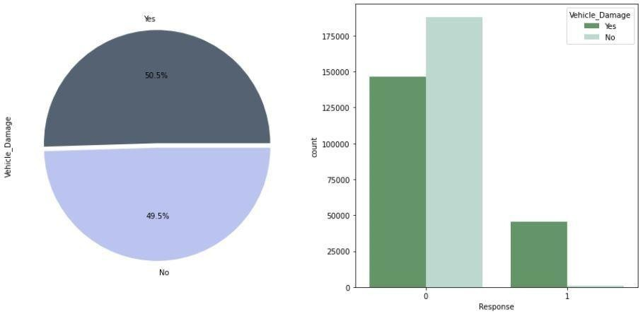
Data Visualization(EDA)
Vehicle Damage feature
We can see from the above graph that customers interested in vehicle insurance are mostly those who had their vehicle damaged in past.

Slide 13
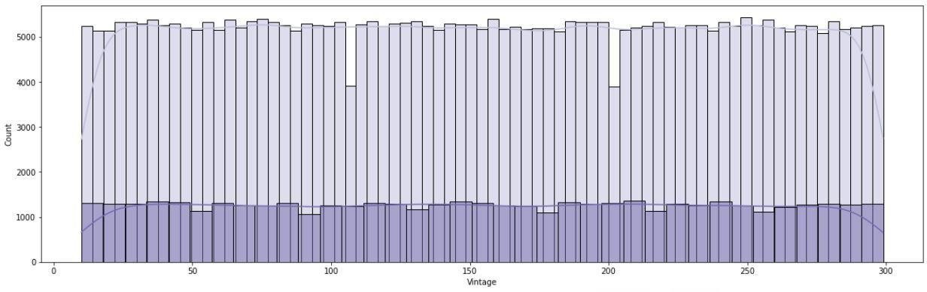
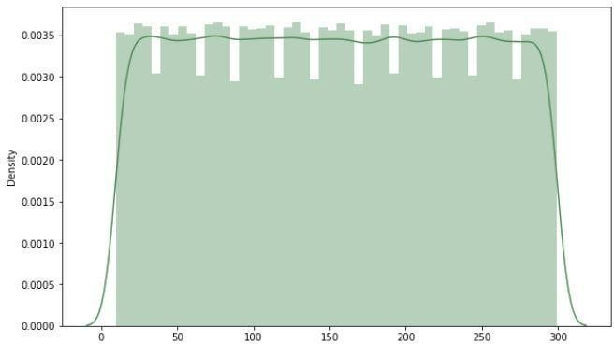
Data Visualization(EDA)
Vintage feature effect on response feature
Number of Days, Customer has been associated with the company.
There seems to be no such relation between vintage and response.

Slide 14
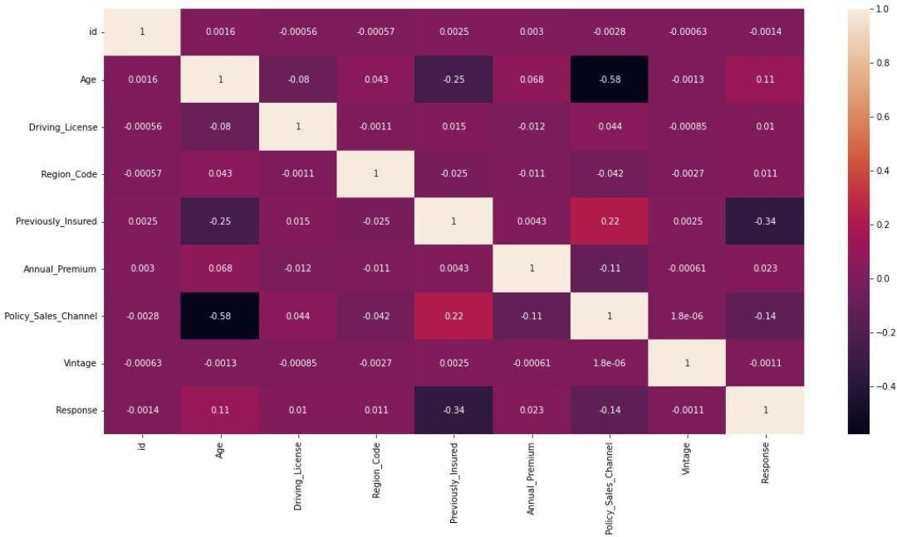

Data Visualization(EDA)
Multivariate analysis
To find a correlation between features
There is no strong correlation among features as we can see from this heatmap

Slide 15
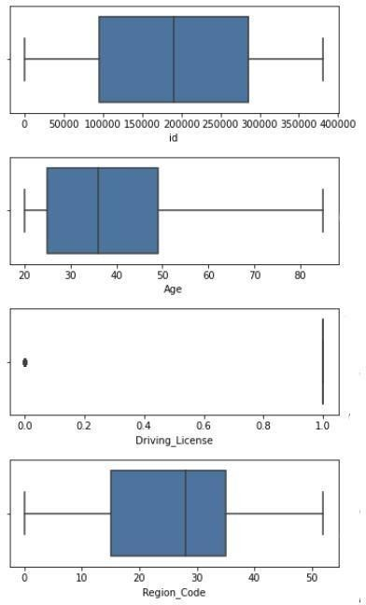
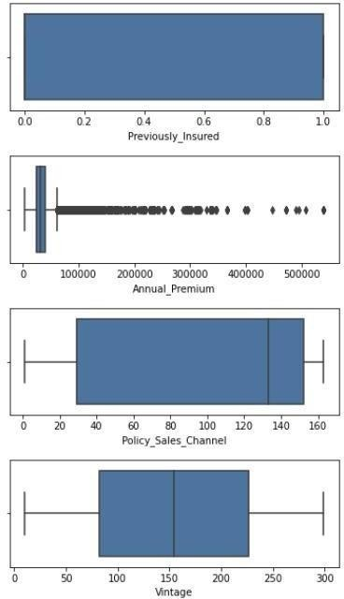
Checking Outliers
Here we check for outliers in each Feature
Annual premium feature contains outliers so we transform annual premium to normal distribution

Slide 16
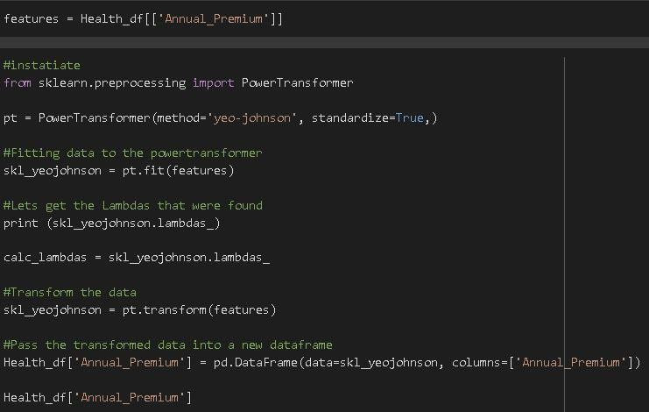
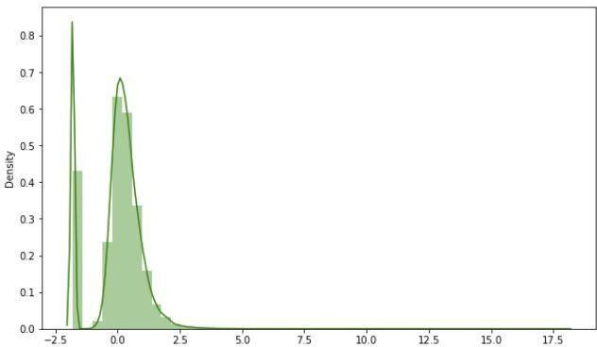
Feature Transformation
Since we have outliers in annual premium and the data is also right-skewed, we apply power Transform to Annual premium.

Slide 17
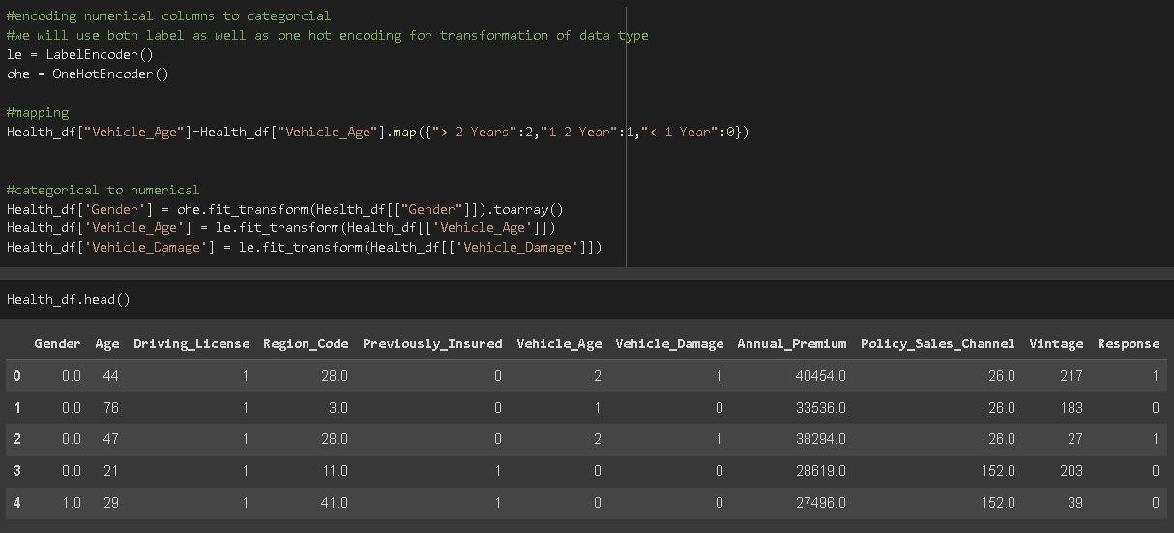
Encoding
Encoding converting data numerical columns to categorical
we will use both labels as well as one hot encoding
for the transformation of data type.

Slide 18
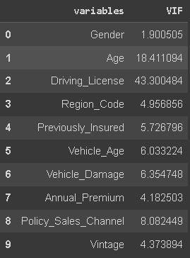
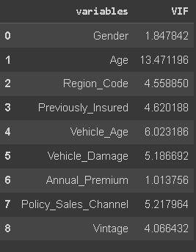
Feature Selection
For feature selection we use VIF (variance inflation factor). VIF for Driving license is highest i.e. 43, which is beyond tolerance level.
Around 99.8% of total customers have a driving license, which makes almost everyone has it.
Thus we drop the Driving License feature from our dataset.
VIF after dropping Driving_license
Initial VIF

Slide 19
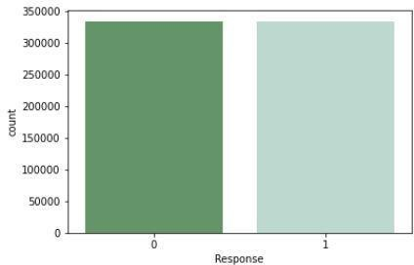
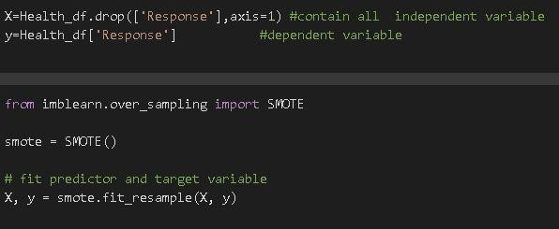
Balancing Imbalanced Dataset
We have highly imbalanced data in our dataset i.e. in our response feature we have 2 variables,1:Customer is interested,0: Customer is not interested.
If we train a binary classification model without fixing this problem, the model will be completely biased towards a majority.
To deal with this problem we will balance our dataset using SMOTE.

Slide 20
Train –Test Split
After applying Smote to balance the data, we now fit dataset to train- test split for training and testing purpose(model evaluation).
Model Selection
Models we will be using here are:-
Logistic Regression
Decision Tree
Random Forest
XGB Classifier

Slide 21
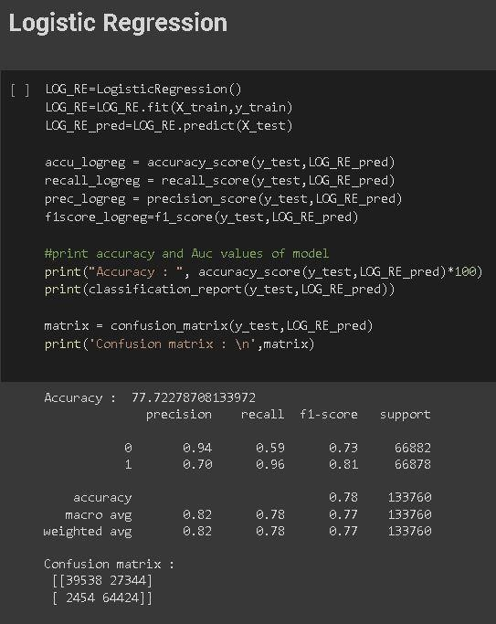
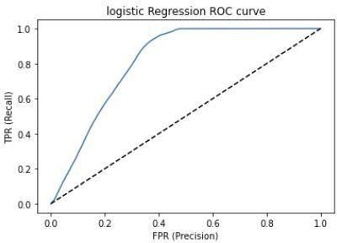
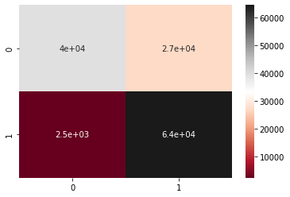
Logistic Regression
Roc-Curve
Confusion Matrix

Slide 22
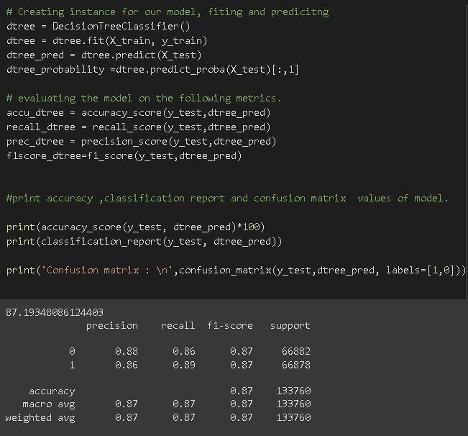
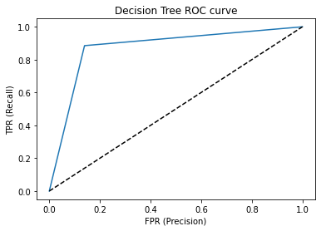
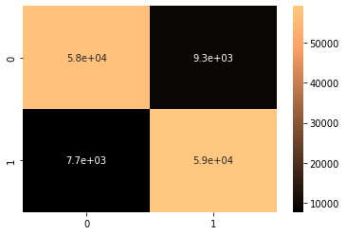
Decision Tree
Roc-Curve
Confusion Matrix

Slide 23
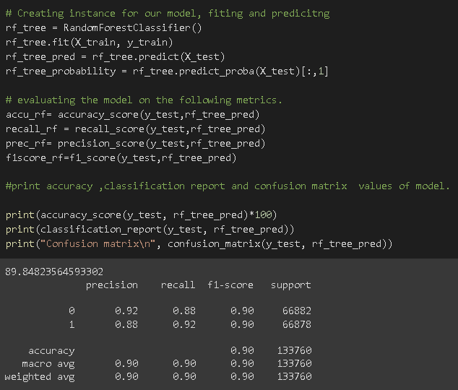
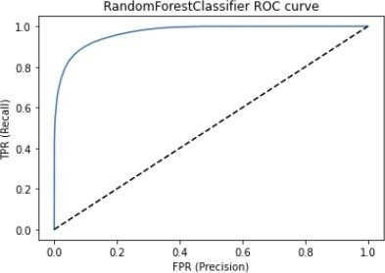
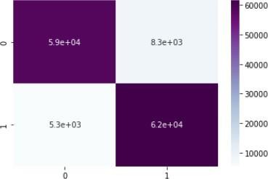
Random Forest classifier
Roc-Curve
Confusion Matrix

Slide 24
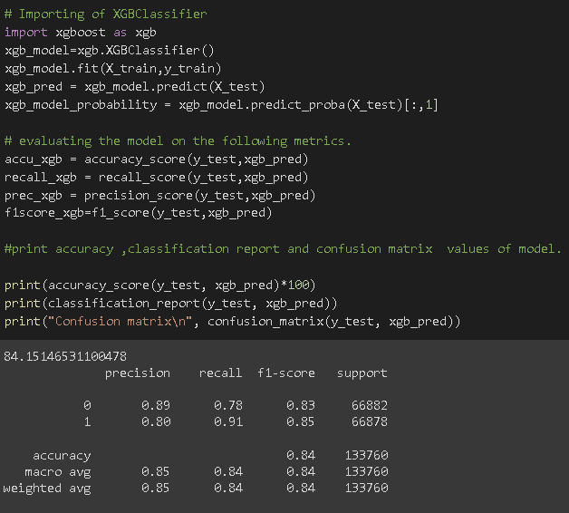
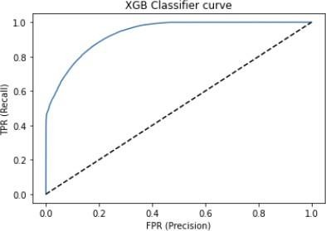
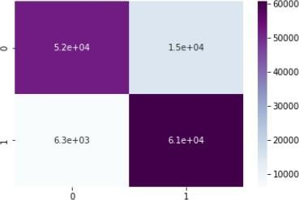
XGB Classifier
Roc - Curve
Confusion Matrix

Slide 25
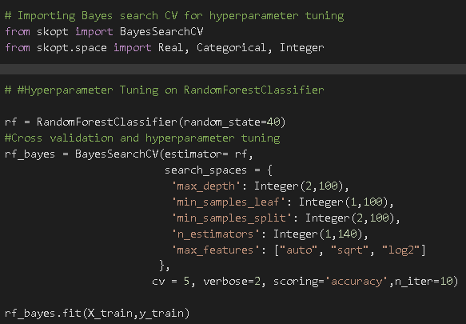
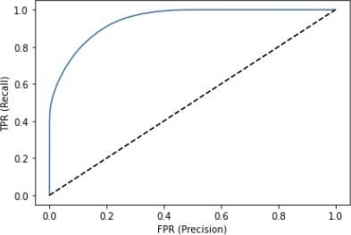
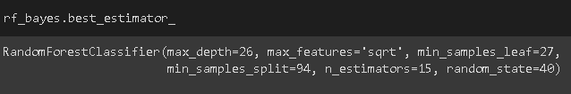
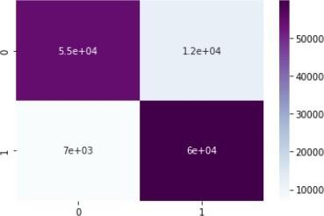
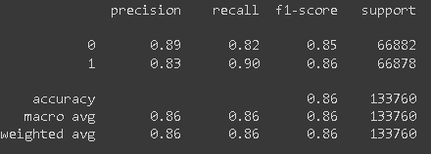
Hyperparameter Tuning (Random Forest Classifier)
Roc-Curve
Confusion Matrix

Slide 26
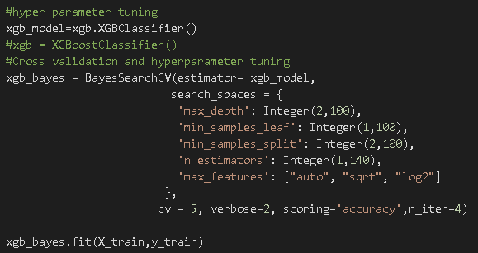


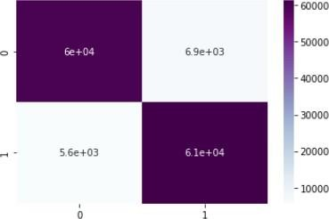
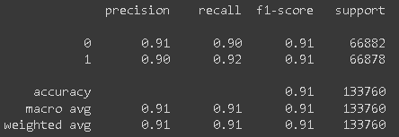
Hyperparameter Tuning (XGBoostClassifier)
Roc-Curve
Confusion Matrix

Slide 27
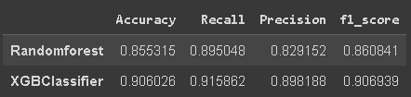
Comparing The Model After Hyperparameter Tuning

Slide 28
Conclusion
The given dataset is an imbalance problem as the Response variable with the value 1 is significantly lower than the value zero
The male customers own slightly more vehicles and they are more tend to buy insurance in comparison to their female counterparts.
Customers of aged between 30 to 60 are more likely to buy insurance. Whereas Youngsters under 30 are not intrigued by vehicle insurance. Reasons could be the absence of involvement, less awareness about insurance and they may not have costly vehicles yet.
Customers who have driving licenses will option of insurance instead of those who don’t have it
Consumers with 1-2-year-old vehicles are more interested in buying insurance. as compared to Consumers with less than 1-year-old Vehicles
Customers with Vehicle Damage are likely to buy insurance as they have experienced the expenditure in repairing vehicles The variable such as Age, Previously insured, and Annual premium more affect the target variable.
We used different types of algorithms to train our model like Logistic Regression, Random Forest model, Decision tree, and XGB Classifier. And Also we tuned the parameters of XGB Classifier and Random Forest model Comparing the model on the basis of precision, recall, accuracy, F1 score we can see that the XGBClassifier model performs better. Even comparing ROC curve XGB Classifier performed better because curves closer to the top-left corner indicate better performance.

Slide 29


